Slide 1
Owhi To Tech:O2T
By
Emre Görkem AĞKURT 19070001042
Uğur BULAN 19070001036
Recyclable Smart Textile Solutions.

Slide 2
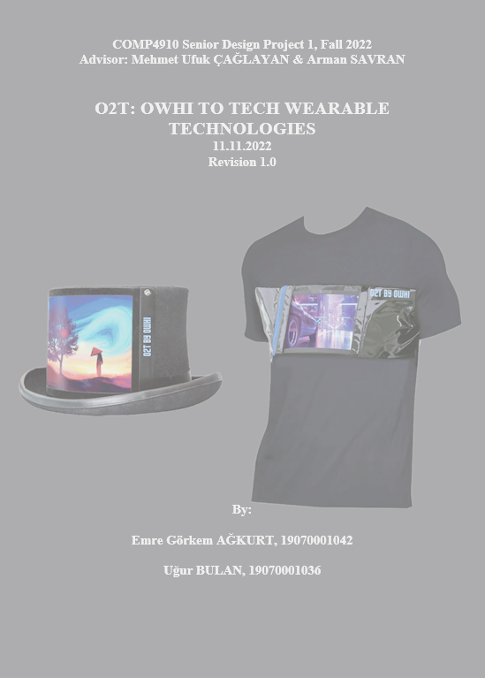
We are O2T
Product Description
Main Goal
Hardware Subsystem Introduction
Software Subsystem Introduction
Workloads Of Ağkurt & Bulan
Future Work
Questions
Includes

Slide 3
Product Description
The O2T project is a wearable technology that aims to introduce a new approach to sustainable fashion and advertising through the development of a wearable textile product with a built-in digital screen controlled by a mobile application.

Slide 4
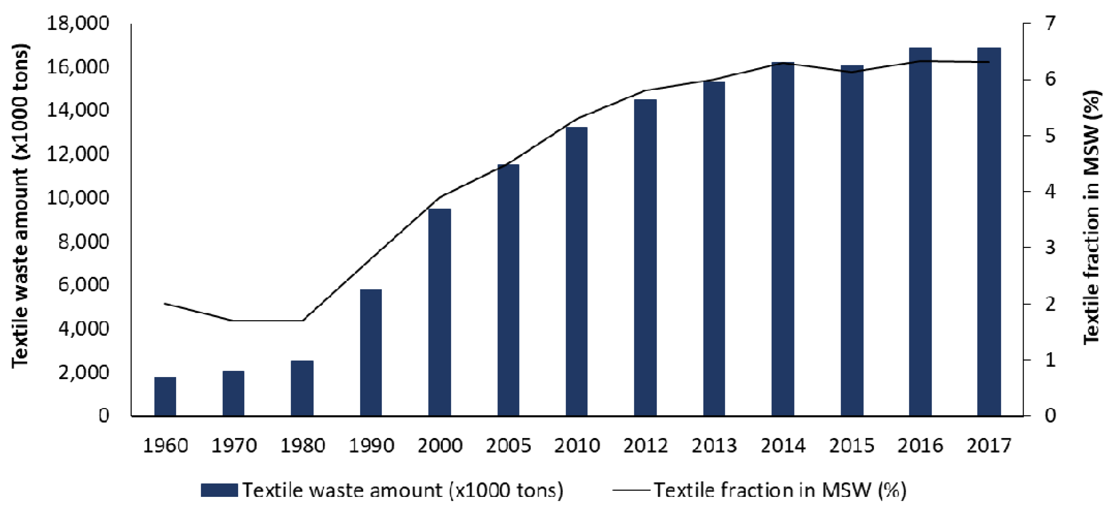
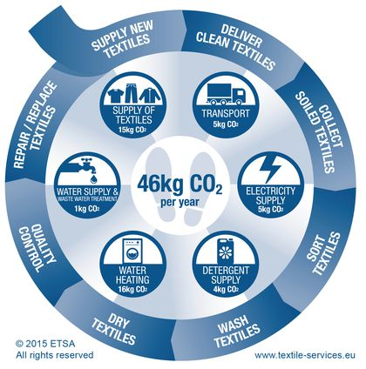
Main Goals
Sustainability and Low Carbon Emissions

Slide 5
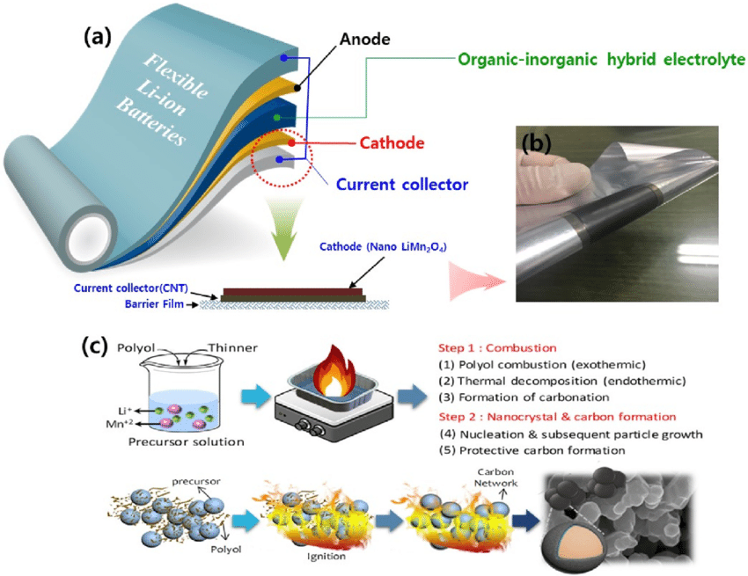
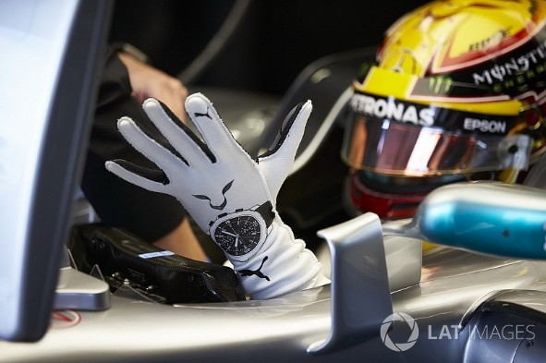
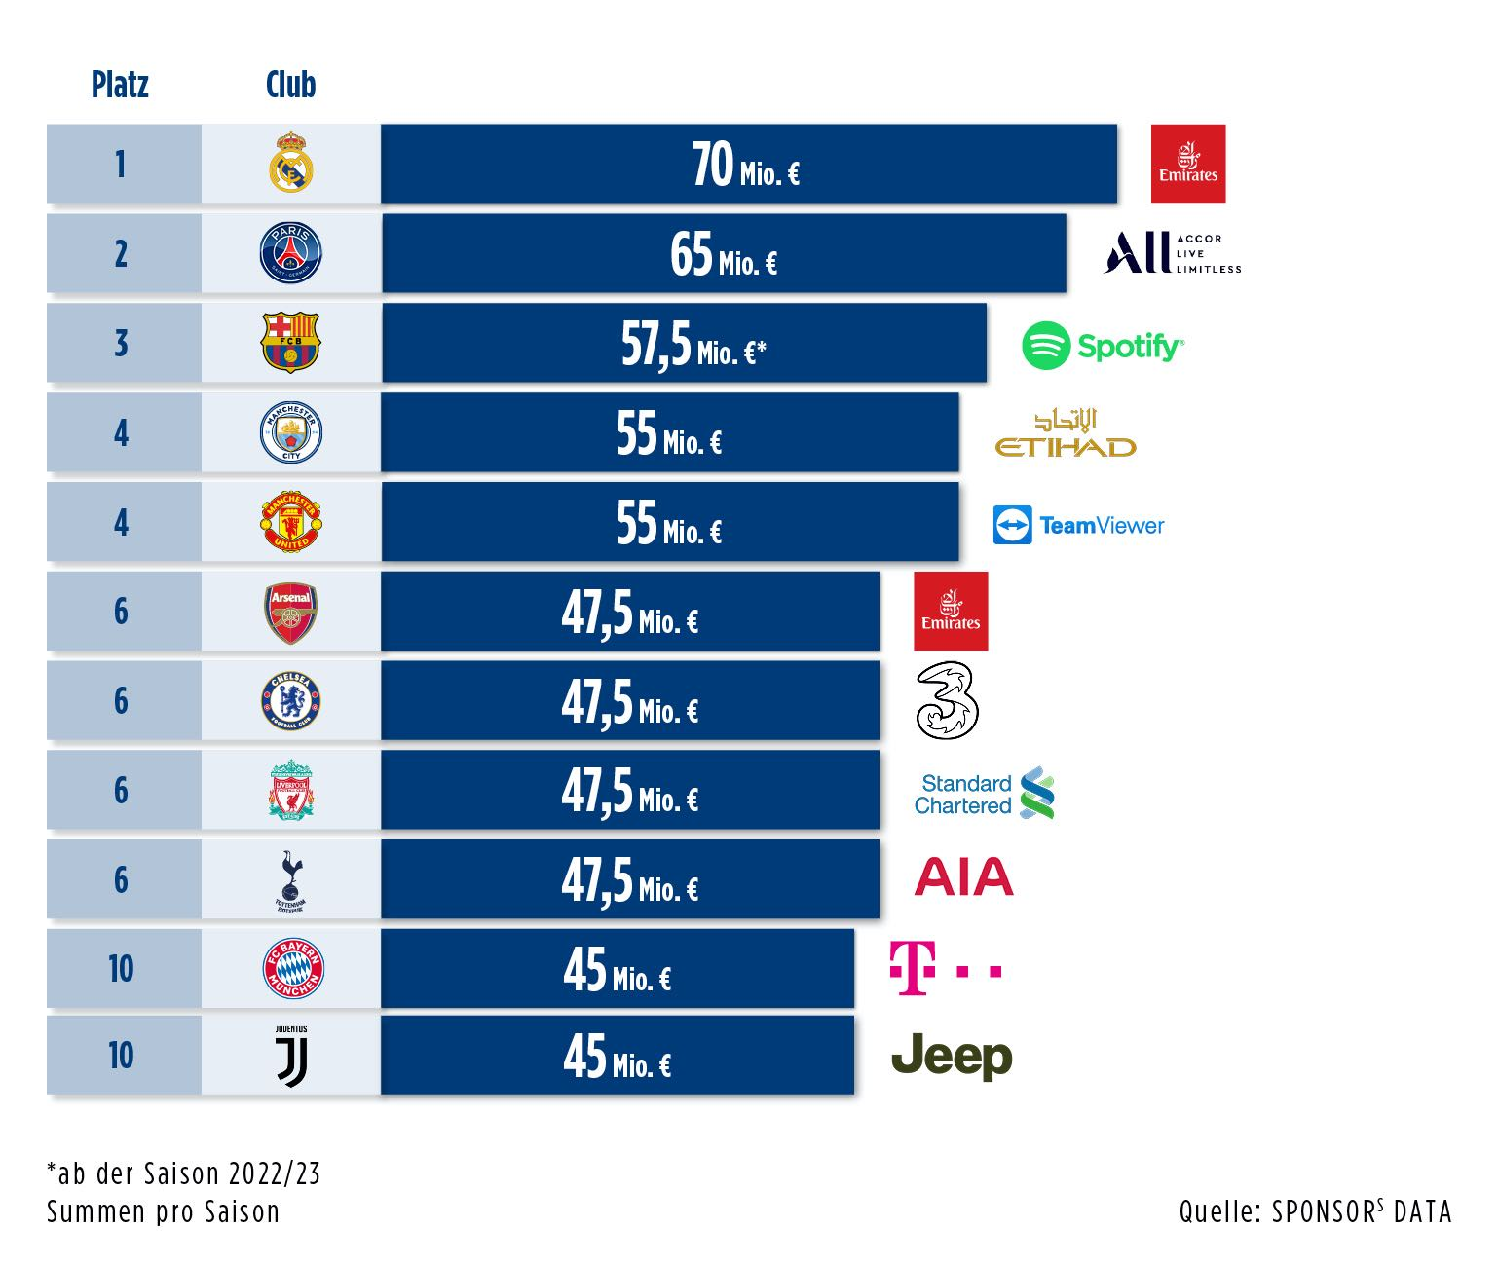
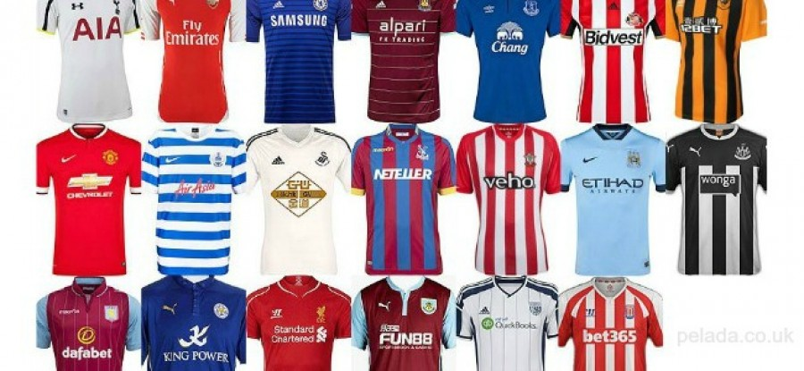
2. Smart Advertising

Slide 6
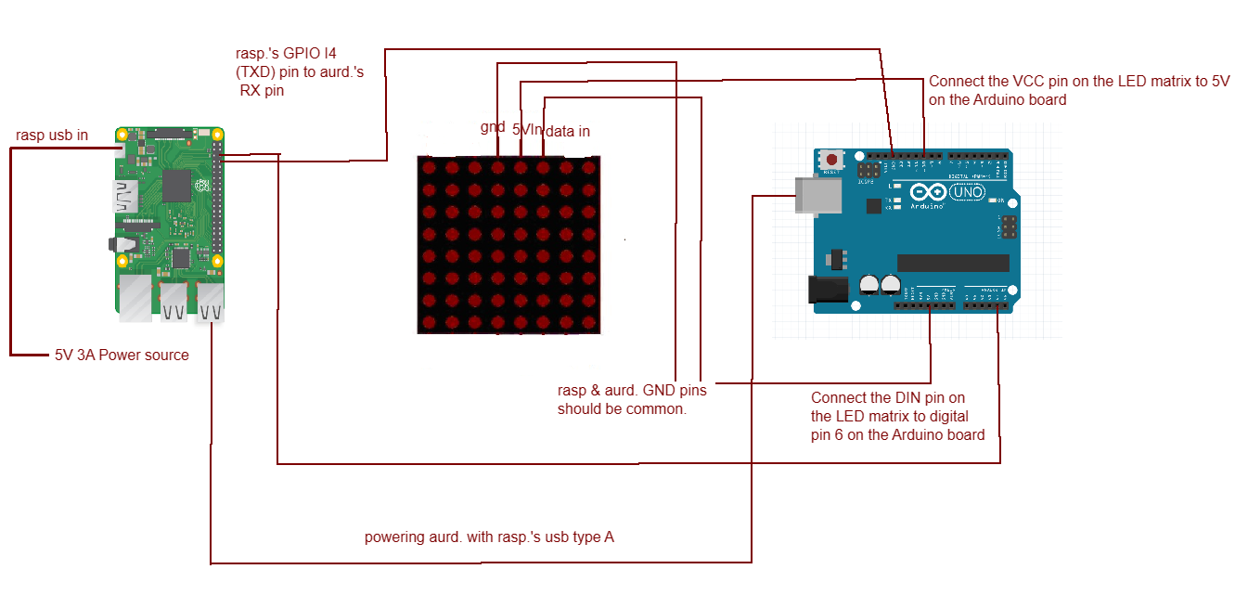
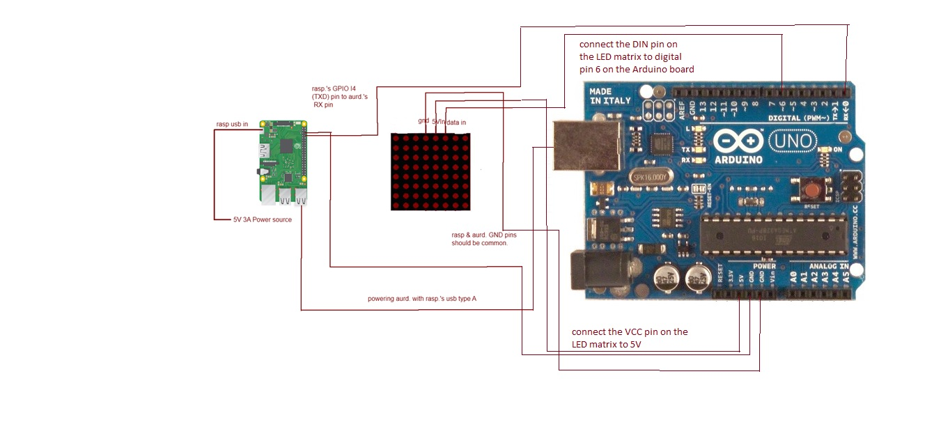
Hardware Subsystem

Slide 7
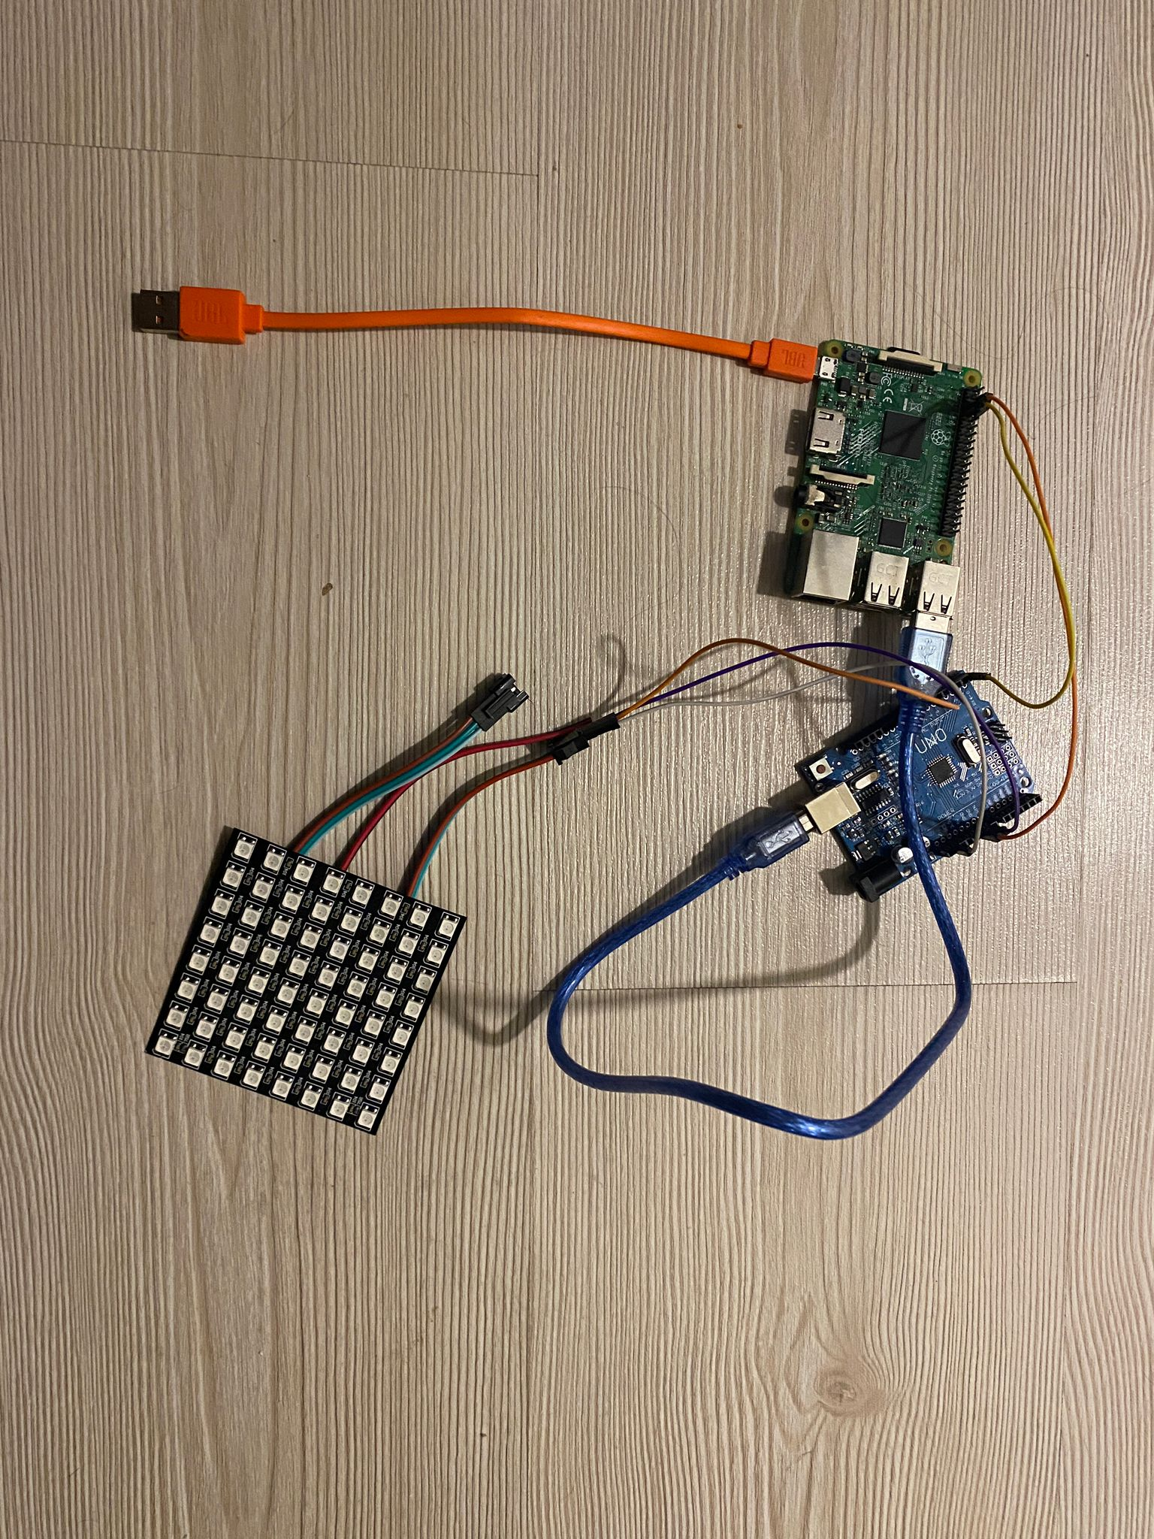

Slide 8
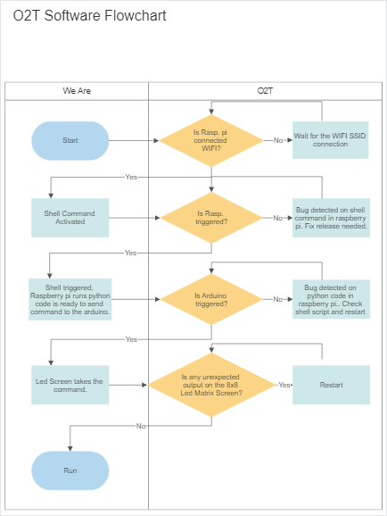
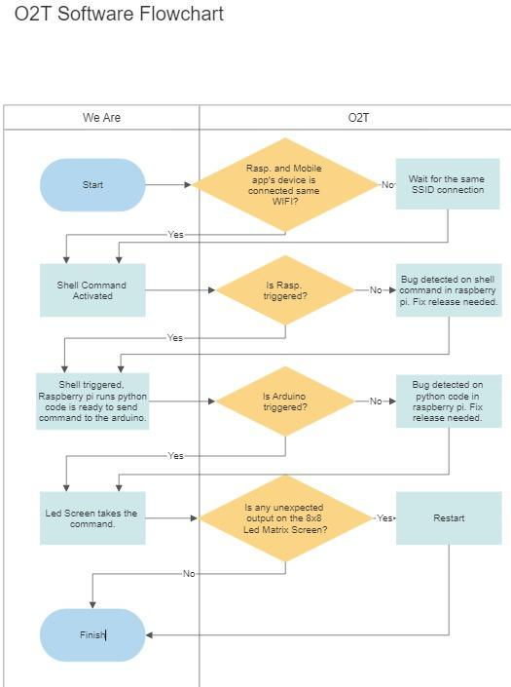



Software Subsystem

Slide 9
Emre Görkem AĞKURT
1. Person
General Ar-Ge / Se-Upg Research about Hardware buying.
Hardware Power Requirements Implementation.
General Design Procedure about Implementation Hardware to the Textile.
General Documantation Procedure
%75
%83
%70
%80
By Order ***

Slide 10
2. Uğur BULAN
2. Person
General Hardware Implementation.
General Ar-Ge / Se-Upg of Software Implementation.
Solid Research & Application of making Mobile Software.
General Documentation Procedure
%75
%83
%75
%90

Slide 11


Future Works

Slide 12
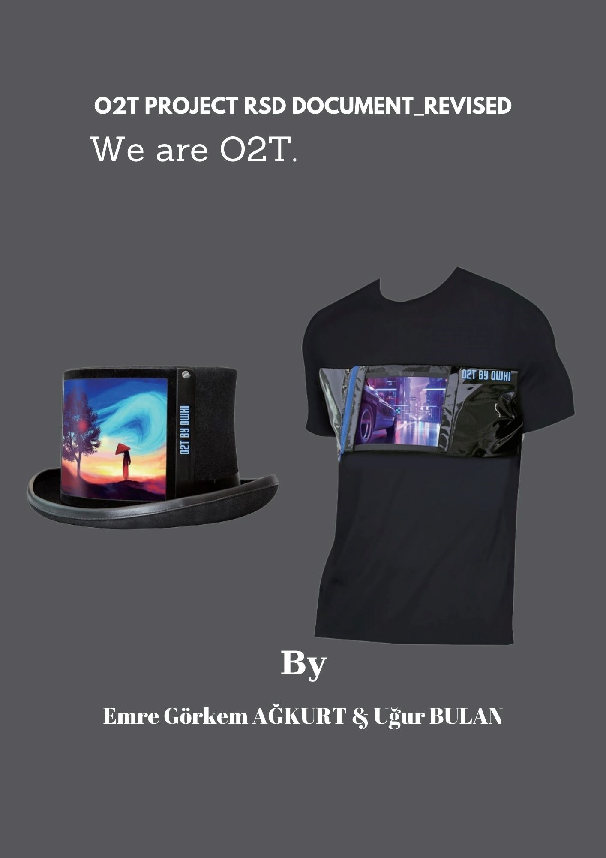
Thanks for the attention
We Are O2T
By Ağkurt & Bulan

